Slide 1
Socket Programming in C#
Edit by Belal Marzouk
Supervised by e.tarek alsati

Slide 2
Introduction to Sockets

Slide 3
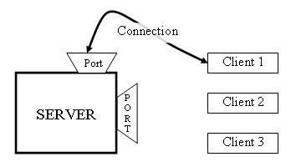
What are Sockets?
End-point of interprocess communication.
An interface through which processes can
send / receive information
Why Sockets?
Used for Interprocess communication.
The Client-Server model
Most interprocess communication uses client-server model
Client & Server are two processes that wants to communicate with each
other
The Client process connects to the Server process, to make a request for
information/services own by the Server.
Once the connection is established between Client process and Server
process, they can start sending / receiving information.

Slide 4
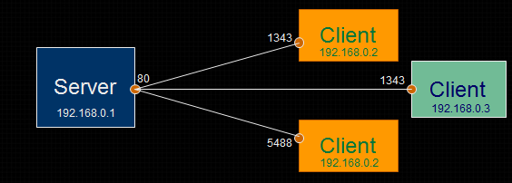
What exactly creates a Socket?
<IP address, Port #> tuple
What makes a connection?
{Source<IP address, Port #> , Destination <IP address, Port #>} i.e. source socket – destination socket pair uniquely identifies a connection.
Example

Slide 5
Socket Types
STREAM – uses TCP which is reliable, stream oriented protocol
DATAGRAM – uses UDP which is unreliable, message oriented protocol
RAW – provides RAW data transfer directly over IP protocol (no transport layer)
Sockets can use
“unicast” ( for a particular IP address destination)
“multicast” ( a set of destinations – 224.x.x.x)
“broadcast” (direct and limited)
“Loopback” address i.e. 127.x.x.x

Slide 6
TCP Algorithms
algorithm for TCP client
Find the IP address and port number of server
Create a TCP socket
Connect the socket to server (Server must be up and listening for new requests)
Send/ receive data with server using the socket
Close the connection
algorithm for TCP server
Find the IP address and port number of server
Create a TCP server socket
Bind the server socket to server IP and Port number (this is the port to which clients will connect)
Accept a new connection from client
returns a client socket that represents the client which is connected
Send/ receive data with client using the client socket
Close the connection with client

Slide 7
UDP Algorithms:
algorithm for UDP client:
Find the IP address and port number of server
Create a UDP socket
Send/ receive data with server using the socket
Close the connection
algorithm for UDP server:
Find the IP address and port number of server
Create a UDP server socket
Bind the server socket to server IP and Port number (this is the port to which clients will send)
Send/ receive data with client using the client socket
Close the connection with client

Slide 8
Introduction to code with c#

Slide 9
IP Addresses in C#
.NET defines two classes in the System.Net namespace:
IPAddress: represent a single IP address.
IPEndPoint: represents a specific IP address/port combination.

Slide 10
IPAddress Methods & Fields
Description | Method/ Field
Converts a string to an IPAddress instance | Parse
Converts an IPAddress to a string representation of the dotted decimal format of the IP address | ToString
Provides an IP address that indicates that the server must listen for client activity on all network interfaces. | Any
Provides the IP broadcast address. | Broadcast
Provides the IP loopback address. | Loopback
Provides an IP address that indicates that no network interface should be used. | None

Slide 11
IPEndPoint Methods
Description | Method
Creates an EndPoint object from a IPAddress and port. | Create
Creates a string representation of the IPEndPoint instance | ToString

Slide 12
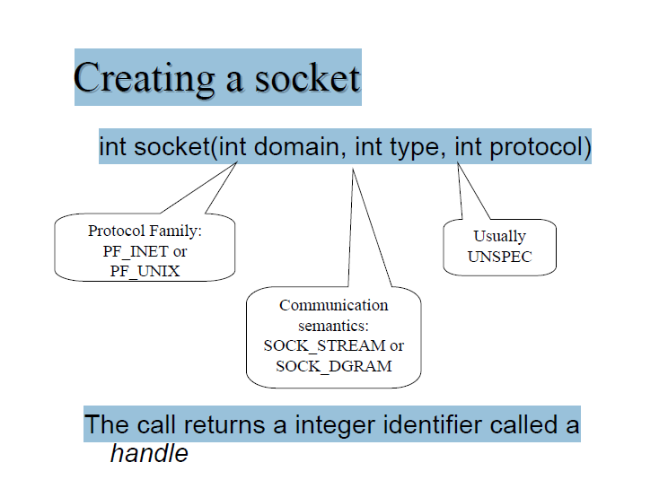

Slide 13
Socket Construction
Socket(AddressFamily af, SocketType st, ProtocolType pt)
Description | Protocoltype | SocketType
Connectionless communication | Udp | Dgram
Connection-oriented communication | Tcp | Stream
Internet Control Message Protocol | Icmp | Raw
Plain IP packet communication | Raw | Raw

Slide 14
Socket Properties
Description | Property
Gets the amount of data that is ready to be read | Available
Gets or sets whether the Socket is in blocking mode | Blocking
Gets a value that indicates if the Socket is connected to a remote device | Connected

Slide 15
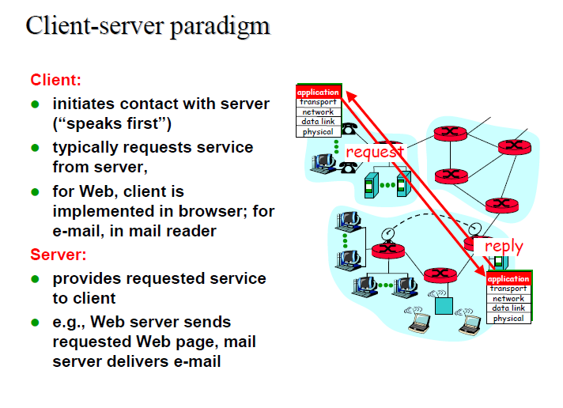

Slide 16
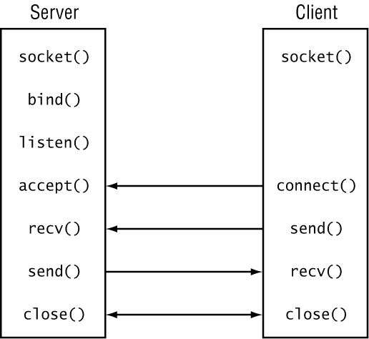
Using Connection-Oriented Sockets

Slide 17
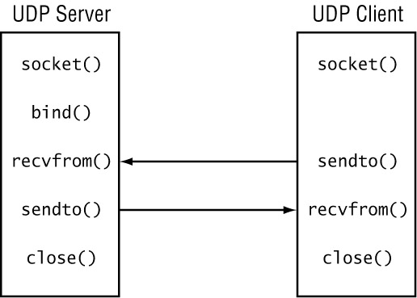
Using Connectionless Sockets

Slide 18
Non-blocking Programming
Non-blocking Sockets
You can set the MySocket.Blocking property of a socket to false, putting the socket into non-blocking mode.
Multiplexed Sockets
The Select() method is used to multiplex multiple Socket instances to watch for the ones that are ready to be read or written to.
- Select(IList read, IList write, IList error, int microseconds)

Slide 19
C# Socket Exceptions
C# uses the try-catch mechanism to catch errors and exceptions as the program is running
try
{
}
catch (SocketException e1)
{
//handle the exception
}

